Slide 1

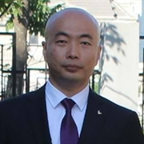

ASP.NET Core MVC
杨旭，微软MVP，.NET Core | ANGULAR Dev

Slide 2

公众号
草根专栏

Slide 3
授权、认证
ASP.Net Core Identity

Slide 4
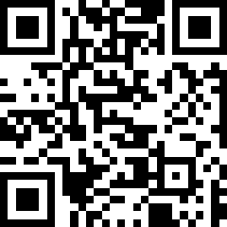
源码
https://0x9.me/xuoYK

Slide 5
Role Manager
RoleManager
创建，删除 Role
把用户添加到 Role
对 Role 进行授权 [Authorize(Roles = “xxxRole”)]

Slide 6

Thanks

